Slide 1
Cortex-A72

Slide 2
Excerpts from Analysis
https://www.anandtech.com/show/9184/arm-reveals-cortex-a72-architecture-details

Slide 3
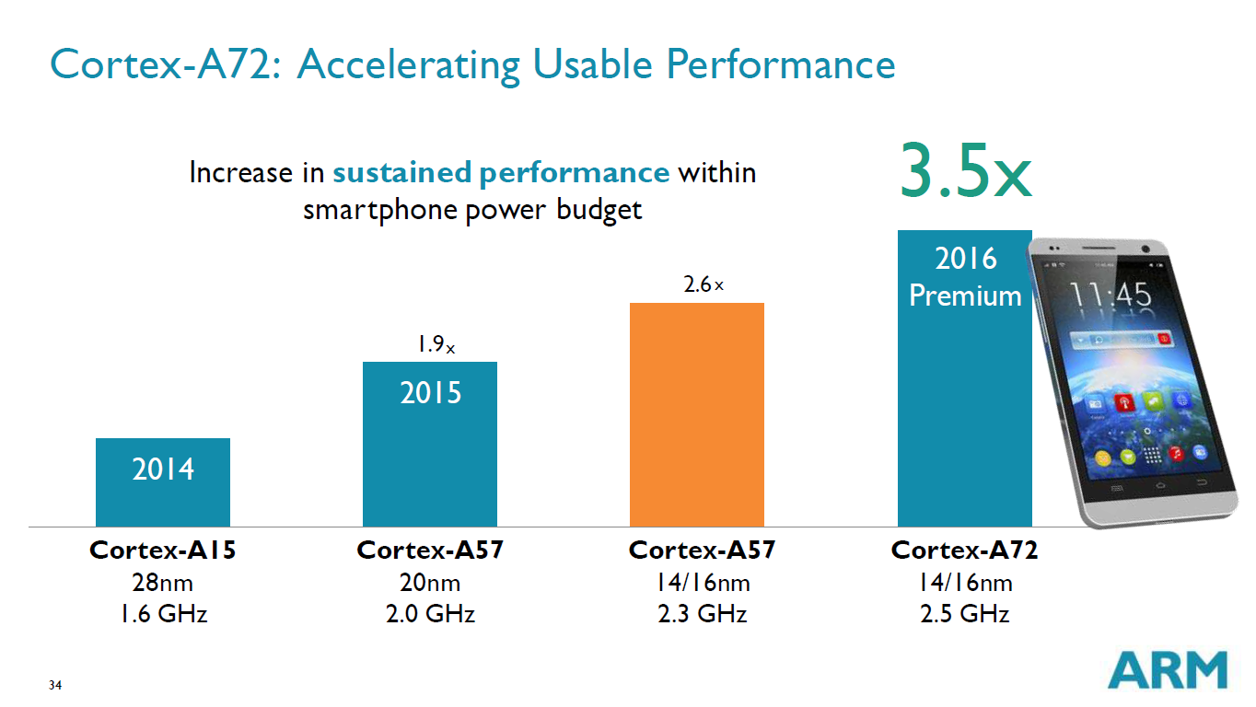

Slide 4
Cortex-A72
Debug and trace, timers, interrupts
Four cores
  Each has Level 1 instruction and data caches
Level 2 memory system
Memory interface

Slide 5
Cortex-A72 Instruction Processing Pipeline

Slide 6
Instruction Latencies
Integer Instruction Type | Result Latency
Branch | 1
Arithmetic, Logic | 1-2
Move, Shift | 1-2
Divide | 4-20. Blocking
Multiply | 3-6
Saturating and Parallel Arithmetic | 2-4
Misc. Data Processing | 1-4
Load | 4-5
Store | 1-3
Other Instruction Type | Result Latency
FP Data Processing | 3-4
FP Divide | 6-11 (SP), 6-18 (DP). Blocking
FP Square Root | 6-17 (SP), 6-32 (DP). Blocking
FP Load | 5-6
FP Store | 1-4
ASIMD Integer | 3-5
ASIMD FP | 3-36
ASIMD Misc. | …
ASIMD Load | …
ASIMD Store | …
Crypto | …
CRC | …

Slide 7
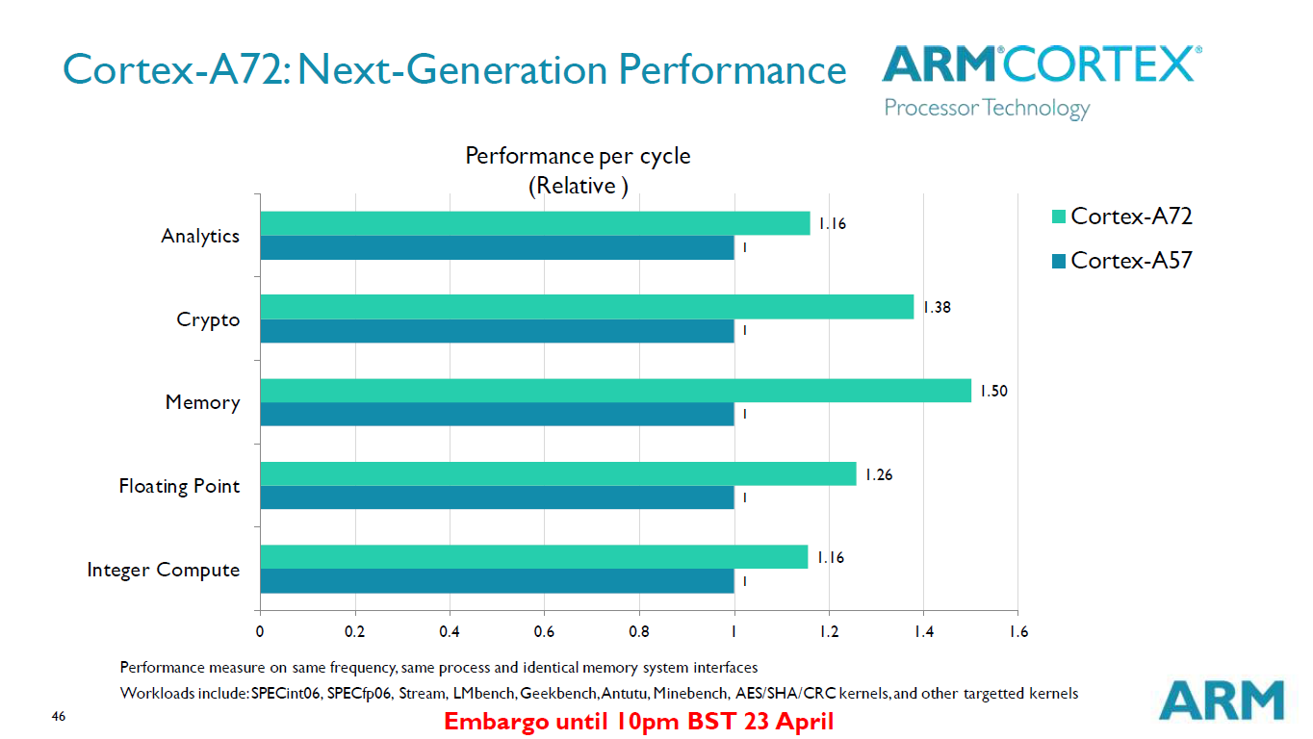

Slide 8
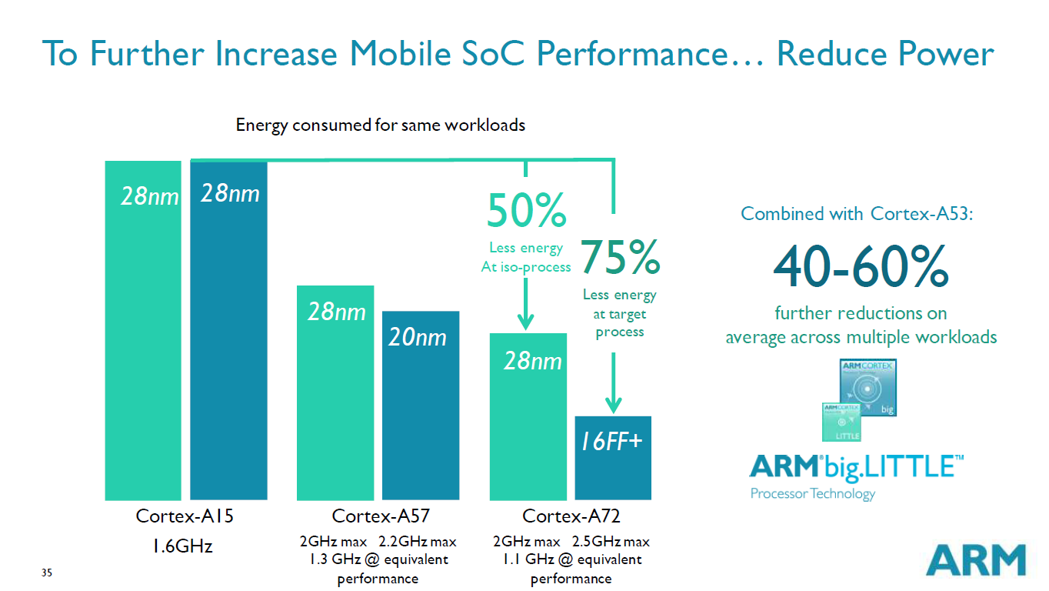

Slide 9
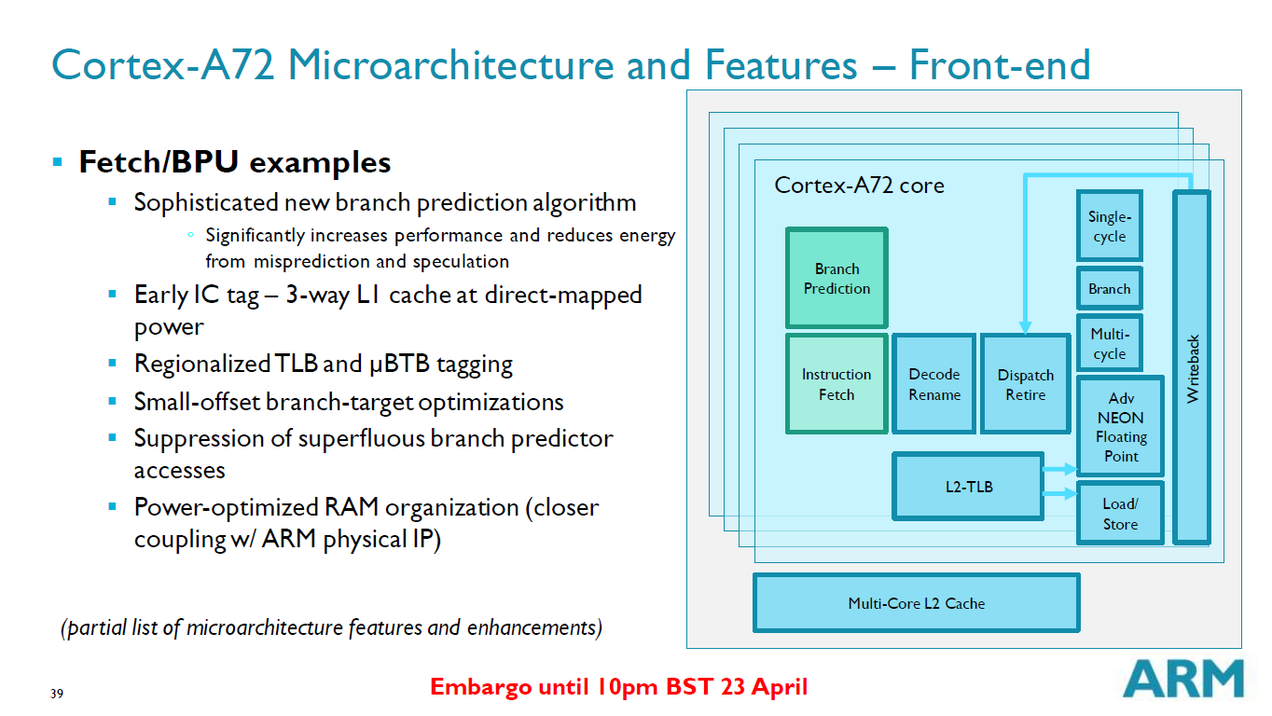

Slide 10
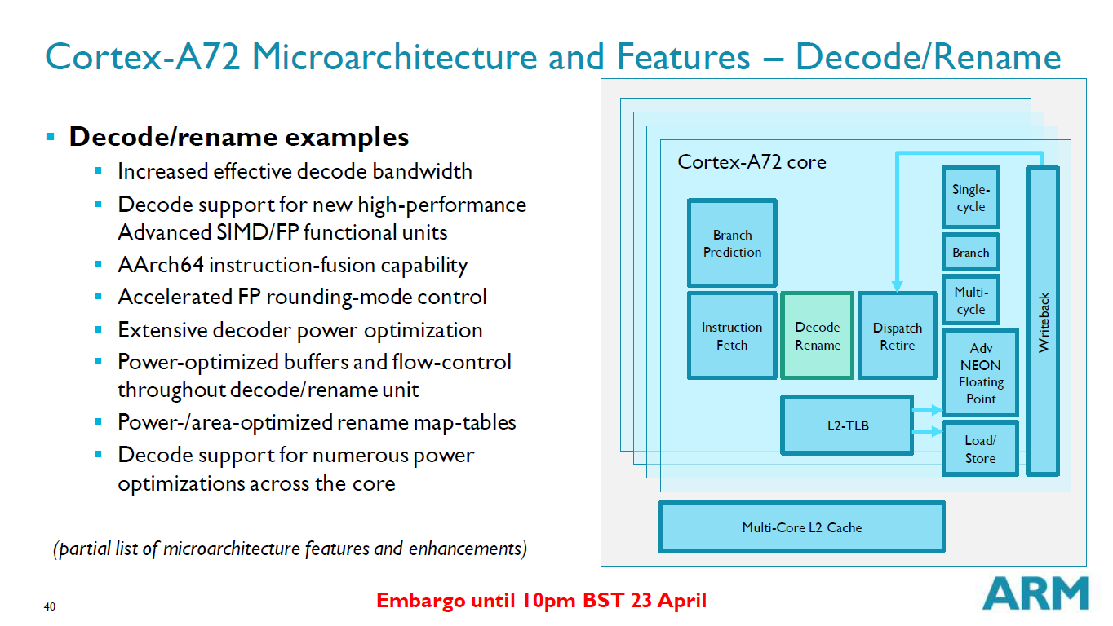

Slide 11
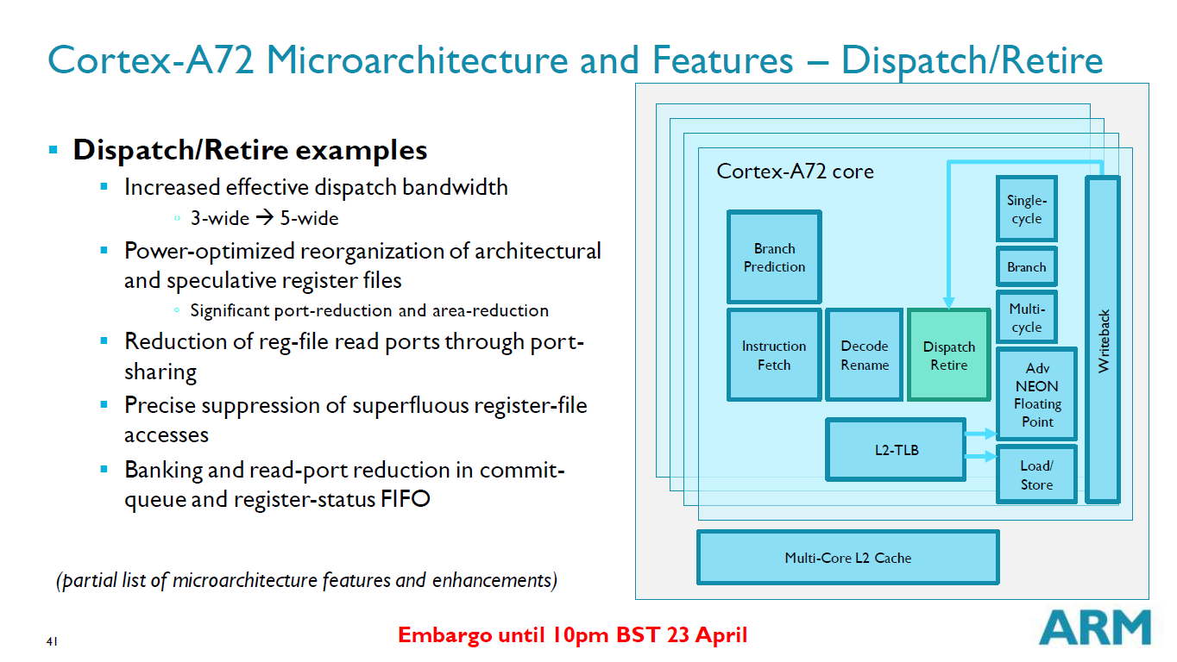

Slide 12
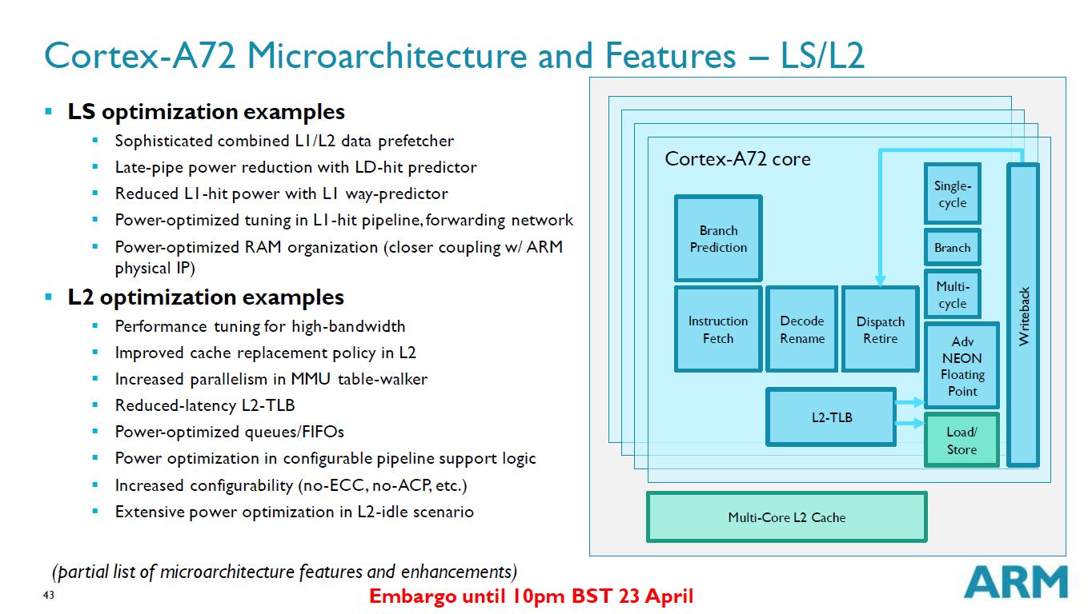

Slide 13
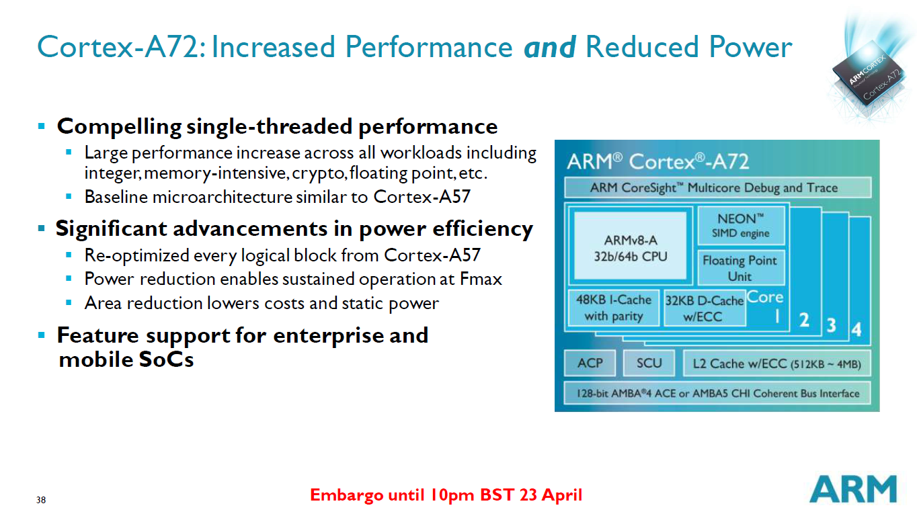

Slide 14
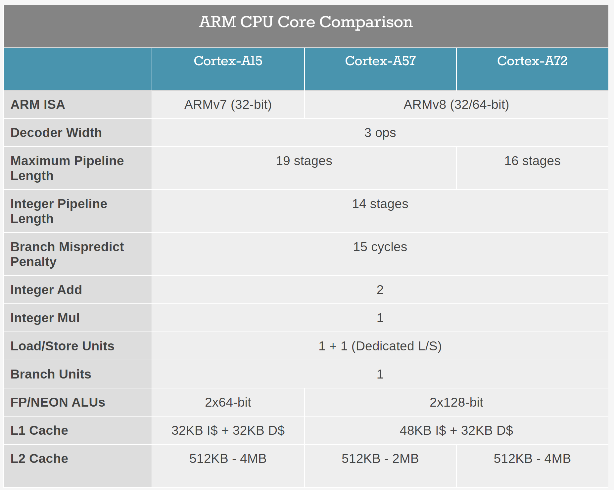
Looking Forward: ARM CPU Core Comparison
Cortex-A73 | Cortex-A75 | Cortex-A76 | Cortex-A77 | Cortex-A78
ARMv8 (32/64-bit)
2 ops | 3 ops | 4 ops | 4 ops | 4 ops
11-12 | 11-13 | 11-13 | 11-13 | ?
Dispatch Width for Out of Order Execution | N/A (in-order) | 3-wide | 5-wide | 4-wide | 6-wide | 8-wide | 10-wide | ?
DMIPS/MHz (Wikipedia) |  | 4.6 | 4.72 | 6.35 | 8.2 - 9.5 | 10.7 -– 12.4 | ? | ?

Slide 15
Appendix: Cortex-A57

Slide 16
Cortex-A57

Slide 17
Cortex-A57 Instruction Pipeline

Slide 18
